Slide 1

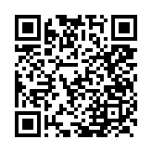




Understanding Learning Styles
Learning Styles Quick Assessment
Visual Learning
Visual learners prefer seeing and using visual aids to absorb information
Mind Mapping
Flashcards with Pictures
Color-Coding
Infographics
Auditory Learning
Auditory learners benefit from listening to absorb information
Podcasts & Audiobooks
Group Discussions
Recording Lectures
Songs or Rhymes
Reading & Writing Learning
Reading and writing learners prefer engaging with written materials and expressing their understanding through writing
Note-taking
Journaling
Creating Outlines
Kinesthetic Learning
Kinesthetic learners learn best when they can physically engage with materials, using their hands and bodies
Hands-On Experiments
Role-Playing
Movement-Based Learning
Building Models
Innovation Lab 117 | ssc.mst.edu | ssc@mst.edu
2

